Slide 1
Introduction to Python & IDEs
Learning Objectives
Describe the key attributes of the Python programming language.
Explain the role of the Jupyter IDE for Python programming.
Use the Jupyter IDE to write a basic Python program.
Write a program which uses string, integer, float and boolean data types.
Expected Prior Knowledge
Experience of working with data using Data Analysis tools such as Excel.

Slide 2
The Python Programming Language

Slide 3
Activity: Discussion
What do you know about the Python programming language?
For example:
What type of language is it?
Is it high or low level?
How is it organised?
Is it compiled or interpreted?
How does it enforce type?

Slide 4
Python is an object-oriented scripting language
First published in 1991 by Guido van Rossum
Designed as an OOP language from day one
Does not need knowledge of OO to use
It is powerful
General purpose, fully functional, rich
Many extension modules
It is free
Open source: Python licence is less restrictive than GPL
It is portable
UNIX, Linux, Windows, OS X, Android, etc…
Ported to the Java and .NET virtual machines
The most common version is written in C
No platform specific functions in the base language
What is Python?
Notes:
Python is a scripting language with a clean and Object Oriented (OO) based interface.
Python was invented by Guido van Rossum, however a much wider community has been involved in its development. Although a free and open source, Python version 2 is copyright BeOpen.com and Stichting Mathematisch Centrum Amsterdam. The Python 3 copyright however is owned by the Python Software Foundation, which was formed in 2001. It is not controlled by the Free Software Foundation, and does not contain any GNU code (although there are optional links), although the licence is "GPL compatible".
Selected links:
Python: http://www.python.org
Jython: http://www.jython.org
Iron Python: http://www.codeplex.com/Wiki/View.aspx?ProjectName=IronPython
There are a number of versions of Python, and they all differ in subtle ways. The most common version, and the one assumed for this course, is known as CPython. It is written in C, for speed and portability, and runs on many platforms. You can even download the source code and compile it yourself.

Slide 5
Power
Garbage collector
Native Unicode objects
Supports many component libraries
GUI libraries like wxPython, PyQt
Scientific libraries like NumPy, DISLIN, SciPy, and many others
Mature JSON support
Web template systems such as Jinja2, Mako and many others
Web frameworks such as Django, Pyjamas, and Zope
Relational Databases support
Libraries may be coded in C or C++
It is “easy”
-er than other, stricter languages
Why Python?
Notes:
Like most modern languages, Python has a garbage collector. This means we do not have to worry too much about tidying up memory (we said "too much", not "at all"). Unicode is the term used to describe multi-byte character sets, i.e. those containing more than 256 characters. Western Europeans may consider these "foreign", but Unicode is required to store and display the Euro currency symbol €.
One of the strengths of community based products like Python is the huge range of add-on libraries, most of them free. They include numeric libraries like NumPy (http://numpy.scipy.org), and DISLIN - a library for data visualization (http://www.mps.mpg.de/dislin) .
JSON (JavaScript Object Notation) is considered an important part of Python, and is heavily used. It is used with Ajax, and is more or less an alternative to XML. There are several web development frameworks, not just those listed, and many other web interfaces, including at least four to the Twitter API (most use JSON).
RDBMS support includes PostgreSQL, Oracle, DB2, Sybase, SAPDB, Informix, Ingres, MySQL, SQLLite, ODBC, and native Python databases buzhug, and SnakeSQL. There have been issues with Microsoft's SQL Server in the past.
The add-ons themselves would not be possible without low-level hooks into the C programming language. Most APIs (Application Program Interfaces) are designed around C, and Python can have libraries written in C. To interface to a 3rd-party product therefore, one "merely" has to write a C-Python wrapper around it.

Slide 6
Performance
Python programs are compiled at runtime into "byte code"
Byte code does not compile down to PE or ELF
Cannot be a fast as well written C
Worse CPU usage than Java and C#
On most benchmarks, but not all
Better memory management
But
Roughly equivalent to Perl and Ruby - depending on the benchmark
Packages often use compiled extensions
Typically, much faster to write
Performance downsides
Notes:
Like many scripting languages, Java, C#, Perl, Ruby, PHP, Python is compiled at runtime into an internal format known as byte-code. It is unrealistic to expect this to run as quickly as C code which has been compiled into a native executable format such as PE COFF (on Windows) or ELF (on UNIX). Despite this, some remarkable benchmarks have been produced where the performance is sometimes comparable. It is worth pointing out that it requires a very good C programmer to produce fast, efficient code which is safe. Achieving safe code in Python is much easier, and quicker.
By the way, as we shall see later, the byte-code produced by a Python module is usually saved, so it only has to be compiled once. This byte-code is not portable.
Further information on benchmarks is available at: http://shootout.alioth.debian.org/gp4/python.php.
Iron Python and Jython perform about the same as CPython, however on all these VM implementations there is continual work on improvements and optimisations.
There are a number of projects working on speeding up Python. Psyco was an old Python 2 package that has maintenance issues - it will not run on 64-bit machines, for example. The development effort on Psyco has moved to PyPy (Python written in Python), which has recently been ported to Python 3.
Google's "Unladen Swallow" project was merged into the base, and has improved the base performance ("Unladen Swallow" comes from a memorable line in "Monty Python and the Holy Grail"), see PEP 3146.

Slide 7
Virtual Environments

Slide 8
Virtual Environments
Best practice is one per project
A folder containing everything your project needs
Including Python!
Modules & Packages
Managed using package manager
PIP
Conda
Notes:
It is generally good practice to use specific virtual environments for specific Python projects.
A virtual environment is essentially a folder containing everything your Python project needs in order to run – no more and no less.
These are usually managed by an environment manager, such as python’s built-in venv or Anaconda’s conda, which you use to add and remove elements from your environment.
By using a virtual environment, you know exactly what your project requires to run, the specific versions of any packages used, as well as the specific version of Python it was built with.
We are going to create an environment using the GUI-based environment that comes with Anaconda, though everything can be done on the command line if you are confident.

Slide 9
Anaconda & Jupyter

Slide 10
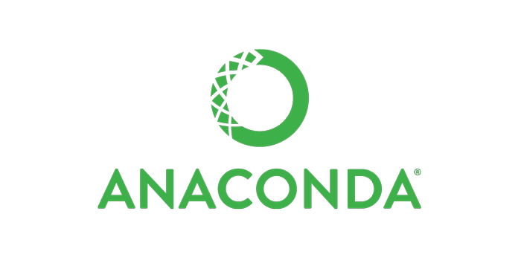

Anaconda and Jupyter
Anaconda is a collection of Python packages, programs, and other software for data analysis and data science.
A Jupyter notebooks are a documentation or commentary-first style of programming, where the key elements are explanations and comments. The code is less important, and often only small amounts.

Slide 11
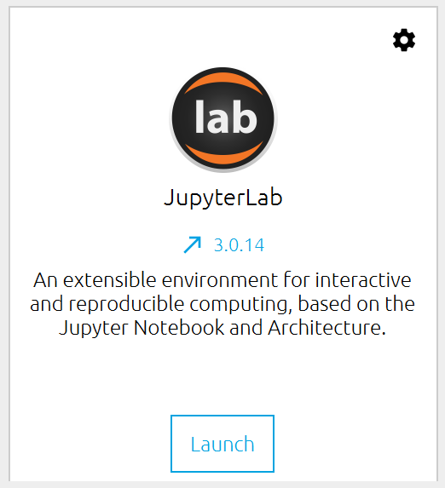
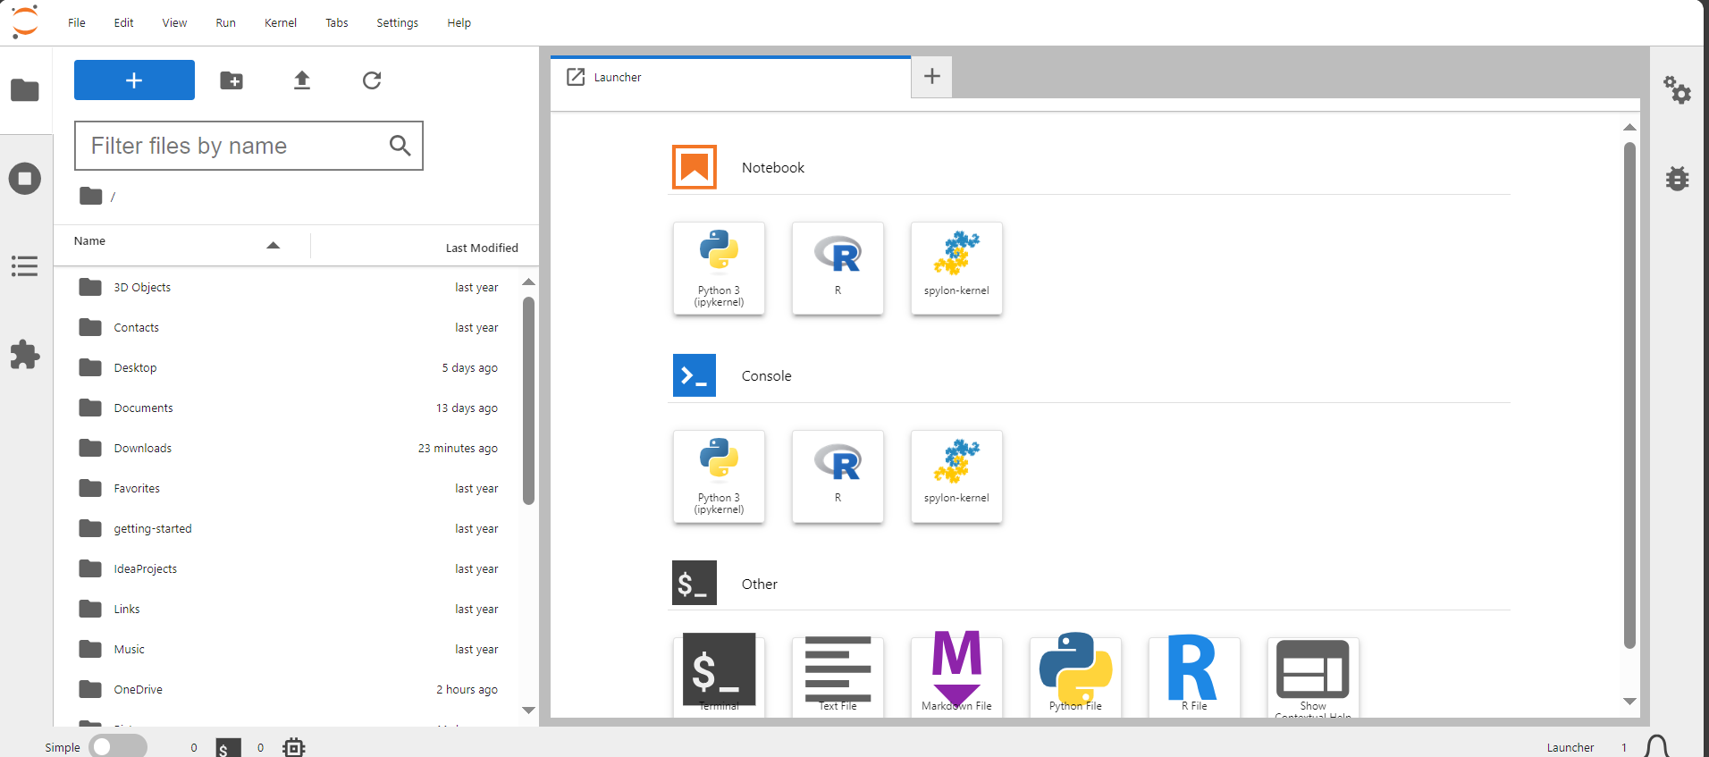
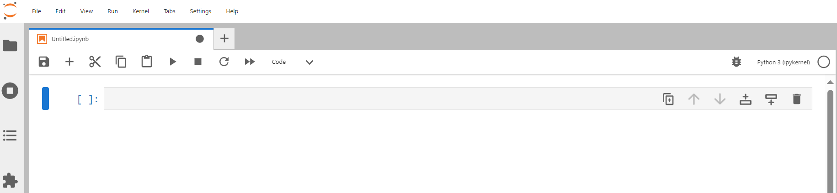
JupyterLab is a superb web-based interactive application for working with Jupyter Notebooks
User Friendly
Easy to debug at each line of code
Why JupyterLab?
Notes:
JupyterLab is an open-source web application that you can use to create and share documents that contain live code, equations, visualisations, and text.

Slide 12
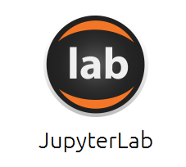
Anaconda Navigator
How do I start Anaconda?
Start Menu > Anaconda Navigator
How do I start JupyterLab?
In Anaconda Navigator, press LAUNCH underneath the JupyterLab icon.

Slide 13


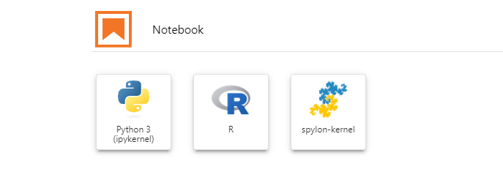
Opening Jupyter
How do I use the file browser?
The file browser can be popped out using the icon. You can then navigate around, find a notebook to open, or create a new notebook.
How do I create notebooks?
Navigate to the labs folder, press the icon, then select Python3 in the launcher.
Jupyter will create a new notebook called ‘Untitled’.
Notes:
The instructor should demo each of these slides as they go along. There is a notebook with the text in it also to aid.

Slide 14
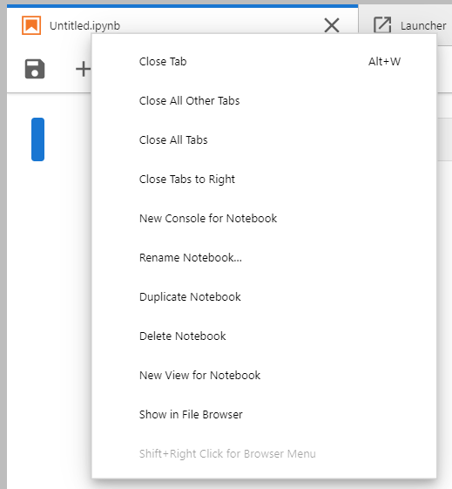
Renaming
Notebooks
How do I rename a notebook?
Right click on the title and select rename. Choose a relevant title, e.g., ‘MyNotes’.

Slide 15
Working with Cells
How do I add and modify cells?
Command mode: ESC (blue bar)
Arrows: move around notebook
m: markdown / text cell
y: code cell / Python cell
a: insert cell above
b: insert cell below
dd: delete cell
z: undo delete
CTRL + ENTER to run
SHIFT + ENTER to run and move one cell below

Slide 16
Working with Cells
How do I edit the contents of cells?
Edit mode: ENTER (green bar)
Type
Use arrows to move around text
CTRL+ENTER: run cell
SHIFT+ENTER: run cell and move one cell below

Slide 17
Working with Cells
How do I add Python code to a notebook?
Add a cell (e.g., press ‘b’) and press ENTER to edit.
How do I run a Python code cell?
Press CTRL + ENTER or the RUN button.
What happens when I run a code cell in Jupyter?
Hopefully you don’t get any errors!
Jupyter always ‘print()’s the last line.
In a usual Python IDE, you would ‘print()’ everything you wish to show on the screen. (What does IDE stand for?)
Notes:
IDE = Integrated Development environment

Slide 18
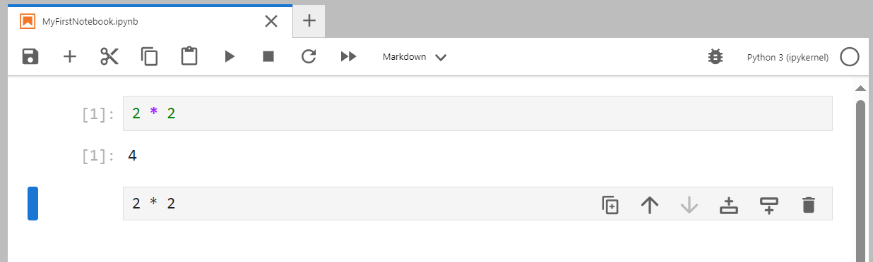
Working with Cells
How do I add a text cell?
Add a cell, change type to markdown, or
Press ‘m’ in command mode.
How do I get help?
‘command?’
‘command??’
‘help(command)’
Notes:
IDE = Integrated Development environment

Slide 19
Working with Cells
How do I find the arguments of a function?
Import statistics
statistics.mean?
How do I stop jupyter from printing the last line of a cell?
Use ‘;’
How do I run command line programs within Jupyter?
Exclamation mark
!dir
How do I install python packages with Jupyter?
!conda install plotly pyspark
Notes:
IDE = Integrated Development environment

Slide 20
Working with Supplied Notebooks
Steps:
Open the notebook.
Select File in the top left, then Duplicate Notebook.
You can rename this new file by clicking on the file name at the top.
Then work from this new notebook:
it will retain all of the original code, in case you accidentally edit or delete.
it will save some guidance outputs that may be inadvertently overwritten.
Notes:
Demo this for the students

Slide 21
Python Fundamentals

Slide 22
If that is an object, what is a variable?
Variables & Objects
What is an object?
To a programmer the term describes a specific area of memory
Objects have type, state, and identity
An object’s type is called its class
Describes the size and format of the area of memory
Describes the actions which may be carried out on the object
Python variables are references to objects
Variables can be deleted with del
An object's memory can be reused when it is no longer referenced
references
variable
a
=
42
object
Notes:
Like most scripting languages, Python variables are defined automatically, and are untyped until assigned. Variables are actually references to objects, so the assignment of a string to a variable makes that variable reference a string object. Uninitialised variables reference an object called None (NULL or undef in other languages).
Being objects, class specific functions, like altering the case of a string, are implemented as methods calls on the object. If you are not familiar with this terminology, a method call is like a conventional function call, with a reference to the variable passed automatically. We shall see examples shortly.
Where the objects themselves are immutable (cannot be altered), then several variables may reference the same physical value.
Unlike most scripting languages, variables defined in a function are local by default - and must be specifically marked as global if required.
When you delete a variable then that removes the name. That will decrement the object's reference count, and when the count reaches zero then the memory can be reused.

Slide 23
Variable Names
Case sensitive
Must start with an underscore or a letter
Followed by any number of letters, digits, or underscores
Conventions with underscores
Underscores represent spaces in names
Names beginning with one underscore are “private”
The character _ represents the result of the previous command

Slide 24
Data Structures in Python:
Primitive data types
Complex data types (collections)
Data Structures in Python at a glance:
primitive data types: integer, string, Boolean, float
complex data types (collections)
list ordered changeable allow duplicates
tuple ordered unchangeable allow duplicates
set unordered changeable no duplicates
dictionary unordered/ changeable no duplicates
ordered (Python 3.7)
changeable = mutable
unchangeable = immutable
Data structures in Python
Notes:
There are many data structures in Python. Primitive data types include, integers, strings, boolean and floats. ******EXPLAIN THIS********
More complex data types are called collections. These include: Lists, tuples, sets, dictionaries etc. ****EXPLAIN****** Talk a bit about Ordered, mutable etc*******

Slide 25
Activity: Tutorial
Code along with the trainer for the following tutorial
Ask questions if you encounter errors
Think about the code you are writing

Slide 26
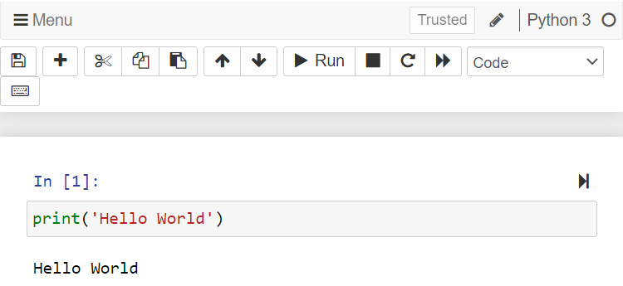
Printing to console window
print ('Hello World')
Click or SHIFT + Enter to run

Slide 27
Data types in Python
There Are Three Basic Variable Types:
Numbers: Integer and Float
1,2,3, 1.23, 0.0005
Character or String
'Hello world’ or "Hello world"
Boolean True or False (case-sensitive)
age=21
salary = 2000.78
company_name='QA Ltd’
is_registered = True
has_icence = False
type is determined automatically;
value can change
Notes:
Python can be said to be built around 3 basic variable types. Numbers, Characters, and Booleans. ***EXPLAIN THESE 3****

Slide 28
Arithmetic operations
The arithmetic operations in Python are:
Addition +
Subtraction –
Multiplication *
Division /
Floor (integer) division //
Modulus (modular division) %
Exponentiation (raising to a power) **

Slide 29
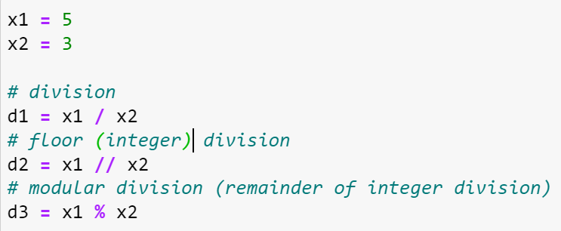
Arithmetic operations: the different types of division
The results of the three types of divisions are:
d1 = 1.6666666667
d2 = 1
d3 = 2
The floor (integer) division doesn’t round, it truncates to obtain the integer result.

Slide 30
Operators & Type
a = 42
b = 9
print(a + b)
print(type(a))
a = 'Hello '
b = 'World!'
print(a + b)
print(type(a))
a and b refer to integers
51
<class 'int'>
a and b now refer to strings
Hello World!
<class 'str'>
Notes:
An operator is usually a symbol (see the slide after the summary) which carries out an operation on a single object (unary operator) or between two operators (binary operator). The result has a value, which may be passed to a function (like print) or used on the right-hand side of an assignment.
Arithmetic operators like + (plus), - (minus), * (multiply), /(divide), and % (modulus) have familiar meanings when used with numbers, but what do they mean when used with strings? Operators have different meanings depending on the type of object they are operating on, some of which are not at all obvious. For example, % does string formatting - something that you would not have guessed!
It is therefore, imperative that we know what type (class) of object we are dealing with, and the type function will tell us that.

Slide 31
Sometimes Python switches automatically
Switching Types
num = 42
pi = 3.142
num = 42/pi
print(num)
num gets automatic promotion
13.367281986
print("Unused port: " + count)
TypeError: Can't convert 'int' object to str implicitly
print("Unused port: " + str(count))

Slide 32
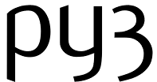
Careful!
Python Reserved Words
False None True and as* assert
async^ await^ break class continue def
del elif else except exec~ finally
for from global if import in
is lambda nonlocal+ not or pass
raise return try while with* yield
* version 2.6 and later
+ version 3.0
~ not in version 3.0
^ version 3.7
exec and print were keywords prior to 3.0, now they are built-in functions

Slide 33
Open 02_Introduction_to_Python_and_IDEs_Exercise.docx
Exercise

Slide 34
Learning check
Think about your answers to these questions
What are the key attributes of the Python programming language.
What is the Jupyter IDE. Why do we use it?
What are Python’s core data types? What are their properties?
What do we call changing the type of an object?

Slide 35
How did you get on?
Learning Objectives
Describe the key attributes of the Python programming language.
Explain the role of the Jupyter IDE for Python programming.
Use the Jupyter IDE to write a basic Python program.
Write a program which uses string, integer, float and boolean data types.

